Slide 1
ECON1002 Intro. Macro.
Tutorial 5
Herbert Xin
wei.xin@sydney.edu.au

Slide 2
Plan of today
Concept Review
1.1. Short-run Equilibrium
1.2. Paradox of Thrift
Tutorial Questions
2.1. Question 1
2.2. Question 3
2.3. Question 4
3. Slides or handwritten note?

Slide 3
Short-run Equilibrium
In the long-run, output is determined by “real” factors, i.e. the potential of economy

Slide 4
Short-run Equilibrium
In the long-run, output is determined by “real” factors, i.e. the potential of economy
In the short-run, output is determined by demand

Slide 5
Short-run Equilibrium
In the long-run, output is determined by “real” factors, i.e. the potential of economy
In the short-run, output is determined by demand
Demand is what people spent, i.e. expenditure

Slide 6
Short-run Equilibrium
In the long-run, output is determined by “real” factors, i.e. the potential of economy
In the short-run, output is determined by demand
Demand is what people spent, i.e. expenditure
When supply catches up with demand, we have equilibrium

Slide 7
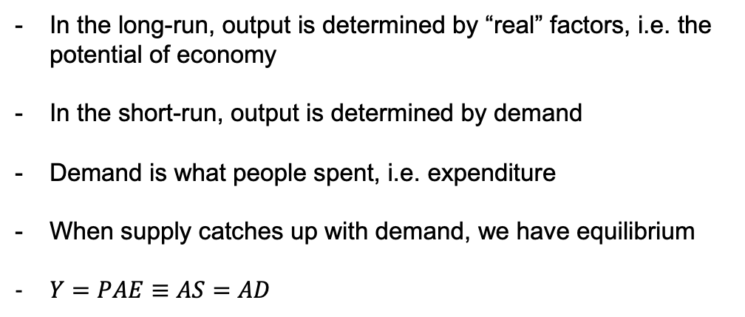
Short-run Equilibrium
In the long-run, output is determined by “real” factors, i.e. the potential of economy
In the short-run, output is determined by demand
Demand is what people spent, i.e. expenditure
When supply catches up with demand, we have equilibrium
$Y=PAE≡AS=AD$

Slide 8
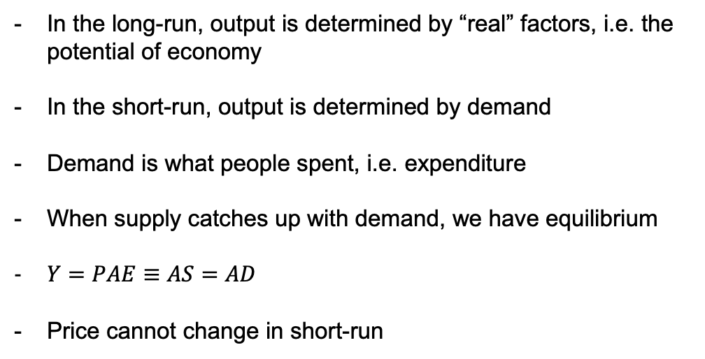
Short-run Equilibrium
In the long-run, output is determined by “real” factors, i.e. the potential of economy
In the short-run, output is determined by demand
Demand is what people spent, i.e. expenditure
When supply catches up with demand, we have equilibrium
$Y=PAE≡AS=AD$
Price cannot change in short-run

Slide 9
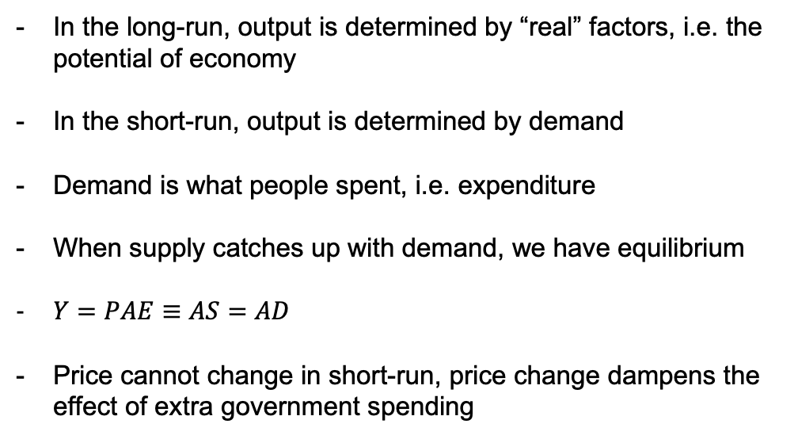
Short-run Equilibrium
In the long-run, output is determined by “real” factors, i.e. the potential of economy
In the short-run, output is determined by demand
Demand is what people spent, i.e. expenditure
When supply catches up with demand, we have equilibrium
$Y=PAE≡AS=AD$
Price cannot change in short-run, price change dampens the effect of extra government spending

Slide 10
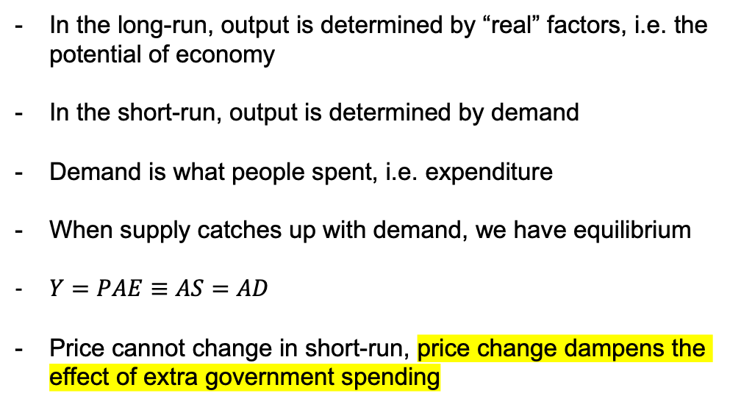
Short-run Equilibrium
In the long-run, output is determined by “real” factors, i.e. the potential of economy
In the short-run, output is determined by demand
Demand is what people spent, i.e. expenditure
When supply catches up with demand, we have equilibrium
$Y=PAE≡AS=AD$
Price cannot change in short-run, price change dampens the effect of extra government spending

Slide 11
Paradox of Thrift
The idea that during recession, the increase of household saving makes the economy even worse.

Slide 12
Paradox of Thrift
The idea that during recession, the increase of household saving makes the economy even worse.
Rather, the correct way is to stimulate spending and increase the output.

Slide 13
Tutorial Problems
1. What are the key assumptions of the Keynesian model? Explain why this assumption is needed if one is to accept the view that aggregate spending is a driving force behind short-term fluctuations.

Slide 14
Tutorial Problems
1. What are the key assumptions of the Keynesian model?

Slide 15
Tutorial Problems
1. What are the key assumptions of the Keynesian model?

Slide 16
Tutorial Problems
1. What are the key assumptions of the Keynesian model?
John Maynard Keynes

Slide 17
Tutorial Problems
1. What are the key assumptions of the Keynesian model?
John Maynard Keynes
1930s “Great Depression”

Slide 18
Tutorial Problems
1. What are the key assumptions of the Keynesian model?
John Maynard Keynes
1930s “Great Depression”
Government Intervention

Slide 19
Tutorial Problems
1. What are the key assumptions of the Keynesian model?
John Maynard Keynes
1930s “Great Depression”
Government Intervention
Laissez-faire

Slide 20
Tutorial Problems
1. What are the key assumptions of the Keynesian model?
John Maynard Keynes
1930s “Great Depression”
Government Intervention
Laissez-faire
Saving the economy

Slide 21
Tutorial Problems
1. What are the key assumptions of the Keynesian model?

Slide 22
Tutorial Problems
1. What are the key assumptions of the Keynesian model?
Short-run model (it is about stimulus)

Slide 23
Tutorial Problems
1. What are the key assumptions of the Keynesian model?
Short-run model (it is about stimulus)
Price are fixed in the short-run

Slide 24
Tutorial Problems
1. What are the key assumptions of the Keynesian model?
Short-run model (it is about stimulus)
Price are fixed in the short-run
Firms meet demand at the pre-set price

Slide 25
Tutorial Problems
1. What are the key assumptions of the Keynesian model?
Short-run model (it is about stimulus)
Price are fixed in the short-run
Firms meet demand at the pre-set price
Investment equals savings

Slide 26
Tutorial Problems
1. What are the key assumptions of the Keynesian model? Explain why this assumption is needed if one is to accept the view that aggregate spending is a driving force behind short-term fluctuations.
Short-run model (it is about stimulus)
Price are fixed in the short-run
Firms meet demand at the pre-set price
Investment equals savings

Slide 27






Tutorial Problems
3. An economy is described by the following equations
$$C=1800+0.6(Y−T)$$
$$I^{P}=900$$
$$G=1500$$
$$NX=100$$
$$T=1500$$
$$Y^{∗}=9000$$

Slide 28
Tutorial Problems
3. An economy is described by the following equations
$$C=1800+0.6(Y−T)$$
a. Find a numerical equation linking planned aggregate expenditure to output
$$I^{P}=900$$
$$G=1500$$
$$NX=100$$
$$T=1500$$
$$Y^{∗}=9000$$

Slide 29

Tutorial Problems
3. An economy is described by the following equations
$$C=1800+0.6(Y−T)$$
a. Find a numerical equation linking planned aggregate expenditure to output
$$I^{P}=900$$
At short-run equilibrium
$$G=1500$$
$$Y=PAE$$
$$NX=100$$
$$T=1500$$
$$Y^{∗}=9000$$

Slide 30

Tutorial Problems
3. An economy is described by the following equations
$$C=1800+0.6(Y−T)$$
a. Find a numerical equation linking planned aggregate expenditure to output
$$I^{P}=900$$
At short-run equilibrium
$$G=1500$$
$$Y=PAE$$
$$NX=100$$
$$PAE=C+I^{P}+G+NX$$
$$T=1500$$
$$Y^{∗}=9000$$

Slide 31
Tutorial Problems
3. An economy is described by the following equations
$$C=1800+0.6(Y−T)$$
a. Find a numerical equation linking planned aggregate expenditure to output
$$I^{P}=900$$
At short-run equilibrium
$$G=1500$$
$$Y=PAE$$
$$NX=100$$
$$PAE=C+I^{P}+G+NX$$
$$T=1500$$
$$PAE=1800+0.6\left(Y−1500\right)+900+1500+100$$
$$Y^{∗}=9000$$

Slide 32

Tutorial Problems
3. An economy is described by the following equations
$$C=1800+0.6(Y−T)$$
a. Find a numerical equation linking planned aggregate expenditure to output
$$I^{P}=900$$
At short-run equilibrium
$$G=1500$$
$$Y=PAE$$
$$NX=100$$
$$PAE=C+I^{P}+G+NX$$
$$T=1500$$
$$PAE=1800+0.6\left(Y−1500\right)+900+1500+100$$
$$Y^{∗}=9000$$
$$PAE=0.6Y+3400$$

Slide 33

Tutorial Problems
3. An economy is described by the following equations
$$C=1800+0.6(Y−T)$$
b. Find the exogenous expenditure and induced expenditure in this economy
$$I^{P}=900$$
$$PAE=0.6Y+3400$$
$$G=1500$$
$$NX=100$$
$$T=1500$$
$$Y^{∗}=9000$$

Slide 34
Tutorial Problems
3. An economy is described by the following equations
$$C=1800+0.6(Y−T)$$
b. Find the exogenous expenditure and induced expenditure in this economy
$$I^{P}=900$$
$$PAE=0.6Y+3400$$
$$G=1500$$
$$NX=100$$
Induced
$$T=1500$$
$$Y^{∗}=9000$$

Slide 35
Tutorial Problems
3. An economy is described by the following equations
$$C=1800+0.6(Y−T)$$
b. Find the exogenous expenditure and induced expenditure in this economy
$$I^{P}=900$$
$$PAE=0.6Y+3400$$
$$G=1500$$
$$NX=100$$
Induced
Exogenous
$$T=1500$$
$$Y^{∗}=9000$$

Slide 36
Tutorial Problems
3. An economy is described by the following equations
$$C=1800+0.6(Y−T)$$
b. What is the output gap for this economy? If the natural rate of unemployment is 4 percent, what is the actual unemployment rate for this economy (use Okun’s law)
$$I^{P}=900$$
$$G=1500$$
$$NX=100$$
$$T=1500$$
$$Y^{∗}=9000$$

Slide 37

Tutorial Problems
3. An economy is described by the following equations
$$C=1800+0.6(Y−T)$$
b. What is the output gap for this economy? If the natural rate of unemployment is 4 percent, what is the actual unemployment rate for this economy (use Okun’s law)
$$I^{P}=900$$
$$G=1500$$
$$X=Y−Y^{∗}$$
$$NX=100$$
$$T=1500$$
$$Y^{∗}=9000$$

Slide 38

Tutorial Problems
3. An economy is described by the following equations
$$C=1800+0.6(Y−T)$$
b. What is the output gap for this economy? If the natural rate of unemployment is 4 percent, what is the actual unemployment rate for this economy (use Okun’s law)
$$I^{P}=900$$
$$G=1500$$
Output Gap
$$X=Y−Y^{∗}$$
$$NX=100$$
$$T=1500$$
$$Y^{∗}=9000$$

Slide 39

Tutorial Problems
3. An economy is described by the following equations
$$C=1800+0.6(Y−T)$$
b. What is the output gap for this economy? If the natural rate of unemployment is 4 percent, what is the actual unemployment rate for this economy (use Okun’s law)
$$I^{P}=900$$
$$G=1500$$
Output Gap
$$X=Y−Y^{∗}$$
$$NX=100$$
$$T=1500$$
$$Y=PAE=0.6Y+3400$$
$$Y^{∗}=9000$$

Slide 40

Tutorial Problems
3. An economy is described by the following equations
$$C=1800+0.6(Y−T)$$
b. What is the output gap for this economy? If the natural rate of unemployment is 4 percent, what is the actual unemployment rate for this economy (use Okun’s law)
$$I^{P}=900$$
$$G=1500$$
Output Gap
$$X=Y−Y^{∗}$$
$$NX=100$$
$$T=1500$$
$$Y=PAE=0.6Y+3400$$
$$Y^{∗}=9000$$

Slide 41

Tutorial Problems
3. An economy is described by the following equations
$$C=1800+0.6(Y−T)$$
b. What is the output gap for this economy? If the natural rate of unemployment is 4 percent, what is the actual unemployment rate for this economy (use Okun’s law)
$$I^{P}=900$$
$$G=1500$$
Output Gap
$$X=Y−Y^{∗}$$
$$NX=100$$
$$T=1500$$
$$Y=PAE=0.6Y+3400$$
$$Y^{∗}=9000$$

Slide 42

Tutorial Problems
3. An economy is described by the following equations
$$C=1800+0.6(Y−T)$$
b. What is the output gap for this economy? If the natural rate of unemployment is 4 percent, what is the actual unemployment rate for this economy (use Okun’s law)
$$I^{P}=900$$
$$G=1500$$
Output Gap
$$X=Y−Y^{∗}$$
$$NX=100$$
$$T=1500$$
$$Y=PAE=0.6Y+3400$$
$$Y^{∗}=9000$$
$$Y=8500$$

Slide 43



Tutorial Problems
3. An economy is described by the following equations
$$C=1800+0.6(Y−T)$$
b. What is the output gap for this economy? If the natural rate of unemployment is 4 percent, what is the actual unemployment rate for this economy (use Okun’s law)
$$I^{P}=900$$
$$G=1500$$
Output Gap
$$X=Y−Y^{∗}$$
$$NX=100$$
$$T=1500$$
$$Y=PAE=0.6Y+3400$$
$$Y^{∗}=9000$$
$$Y=8500$$

Slide 44


Tutorial Problems
3. An economy is described by the following equations
$$C=1800+0.6(Y−T)$$
b. What is the output gap for this economy? If the natural rate of unemployment is 4 percent, what is the actual unemployment rate for this economy (use Okun’s law)
$$I^{P}=900$$
$$G=1500$$
Output Gap
$$X=Y−Y^{∗}$$
$$NX=100$$
$$T=1500$$
$$Y=PAE=0.6Y+3400$$
$$Y^{∗}=9000$$
$$Y=8500$$

Slide 45


Tutorial Problems
3. An economy is described by the following equations
$$C=1800+0.6(Y−T)$$
b. What is the output gap for this economy? If the natural rate of unemployment is 4 percent, what is the actual unemployment rate for this economy (use Okun’s law)
$$I^{P}=900$$
$$G=1500$$
Output Gap
$$X=Y−Y^{∗}$$
$$NX=100$$
$$T=1500$$
$$Y=PAE=0.6Y+3400$$
$$Y^{∗}=9000$$
$$Y=8500$$
$$X=8500−9000=−500$$

Slide 46
Tutorial Problems
3. An economy is described by the following equations
$$C=1800+0.6(Y−T)$$
b. What is the output gap for this economy? If the natural rate of unemployment is 4 percent, what is the actual unemployment rate for this economy (use Okun’s law)
$$I^{P}=900$$
$$G=1500$$
$$NX=100$$
$$T=1500$$
$$Y^{∗}=9000$$

Slide 47
Tutorial Problems
3. An economy is described by the following equations
$$C=1800+0.6(Y−T)$$
b. What is the output gap for this economy? If the natural rate of unemployment is 4 percent, what is the actual unemployment rate for this economy (use Okun’s law)
$$I^{P}=900$$
$$G=1500$$
$$NX=100$$
$$T=1500$$
$$Y^{∗}=9000$$

Slide 48
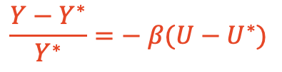
Tutorial Problems
3. An economy is described by the following equations
$$C=1800+0.6(Y−T)$$
b. What is the output gap for this economy? If the natural rate of unemployment is 4 percent, what is the actual unemployment rate for this economy (use Okun’s law)
$$I^{P}=900$$
$$G=1500$$
$$\frac{Y−Y^{∗}}{Y^{∗}}=− β(U−U^{∗})$$
$$NX=100$$
$$T=1500$$
$$Y^{∗}=9000$$

Slide 49
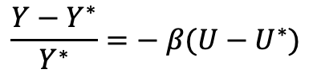
Tutorial Problems
3. An economy is described by the following equations
$$C=1800+0.6(Y−T)$$
b. What is the output gap for this economy? If the natural rate of unemployment is 4 percent, what is the actual unemployment rate for this economy (use Okun’s law)
$$I^{P}=900$$
$$G=1500$$
$$\frac{Y−Y^{∗}}{Y^{∗}}=− β(U−U^{∗})$$
$$NX=100$$
$$T=1500$$
$$Y^{∗}=9000$$

Slide 50
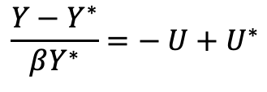
Tutorial Problems
3. An economy is described by the following equations
$$C=1800+0.6(Y−T)$$
b. What is the output gap for this economy? If the natural rate of unemployment is 4 percent, what is the actual unemployment rate for this economy (use Okun’s law)
$$I^{P}=900$$
$$G=1500$$
$$\frac{Y−Y^{∗}}{Y^{∗}}=− β(U−U^{∗})$$
$$NX=100$$
$$T=1500$$
$$\frac{Y−Y^{∗}}{βY^{∗}}=− U+U^{∗}$$
$$Y^{∗}=9000$$

Slide 51
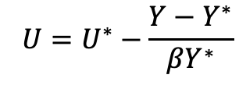
Tutorial Problems
3. An economy is described by the following equations
$$C=1800+0.6(Y−T)$$
b. What is the output gap for this economy? If the natural rate of unemployment is 4 percent, what is the actual unemployment rate for this economy (use Okun’s law)
$$I^{P}=900$$
$$G=1500$$
$$\frac{Y−Y^{∗}}{Y^{∗}}=− β(U−U^{∗})$$
$$NX=100$$
$$T=1500$$
$$\frac{Y−Y^{∗}}{βY^{∗}}=− U+U^{∗}$$
$$Y^{∗}=9000$$
$$U=U^{∗}−\frac{Y−Y^{∗}}{βY^{∗}}$$

Slide 52
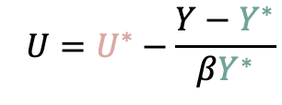
Tutorial Problems
3. An economy is described by the following equations
$$C=1800+0.6(Y−T)$$
b. What is the output gap for this economy? If the natural rate of unemployment is 4 percent, what is the actual unemployment rate for this economy (use Okun’s law)
$$I^{P}=900$$
$$G=1500$$
$$\frac{Y−Y^{∗}}{Y^{∗}}=− β(U−U^{∗})$$
$$NX=100$$
$$T=1500$$
$$\frac{Y−Y^{∗}}{βY^{∗}}=− U+U^{∗}$$
$$Y^{∗}=9000$$
$$U=U^{∗}−\frac{Y−Y^{∗}}{βY^{∗}}$$

Slide 53
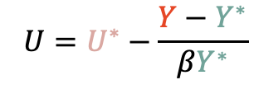
Tutorial Problems
3. An economy is described by the following equations
$$C=1800+0.6(Y−T)$$
b. What is the output gap for this economy? If the natural rate of unemployment is 4 percent, what is the actual unemployment rate for this economy (use Okun’s law)
$$I^{P}=900$$
$$G=1500$$
$$\frac{Y−Y^{∗}}{Y^{∗}}=− β(U−U^{∗})$$
$$NX=100$$
$$T=1500$$
$$\frac{Y−Y^{∗}}{βY^{∗}}=− U+U^{∗}$$
$$Y^{∗}=9000$$
8500
$$U=U^{∗}−\frac{Y−Y^{∗}}{βY^{∗}}$$

Slide 54
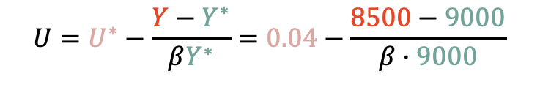
Tutorial Problems
3. An economy is described by the following equations
$$C=1800+0.6(Y−T)$$
b. What is the output gap for this economy? If the natural rate of unemployment is 4 percent, what is the actual unemployment rate for this economy (use Okun’s law)
$$I^{P}=900$$
$$G=1500$$
$$\frac{Y−Y^{∗}}{Y^{∗}}=− β(U−U^{∗})$$
$$NX=100$$
$$T=1500$$
$$\frac{Y−Y^{∗}}{βY^{∗}}=− U+U^{∗}$$
$$Y^{∗}=9000$$
$$U=U^{∗}−\frac{Y−Y^{∗}}{βY^{∗}}=0.04−\frac{8500−9000}{β⋅9000}$$

Slide 55






Tutorial Problems
4. An economy is described by the following equations. The multiplier is 5.
$$C=40+0.8(Y−T)$$
$$I^{P}=70$$
$$G=120$$
$$NX=0$$
$$T=150$$
$$Y^{∗}=580$$

Slide 56
Tutorial Problems
4. An economy is described by the following equations. The multiplier is 5.
$$C=40+0.8(Y−T)$$
a. Find short-run equilibrium output.
$$I^{P}=70$$
$$G=120$$
$$NX=0$$
$$T=150$$
$$Y^{∗}=580$$

Slide 57
Tutorial Problems
4. An economy is described by the following equations. The multiplier is 5.
$$C=40+0.8(Y−T)$$
a. Find short-run equilibrium output.
$$I^{P}=70$$
$$G=120$$
$$NX=0$$
$$T=150$$
$$Y^{∗}=580$$

Slide 58

Tutorial Problems
4. An economy is described by the following equations. The multiplier is 5.
$$C=40+0.8(Y−T)$$
a. Find short-run equilibrium output.
$$I^{P}=70$$
$$Y=PAE$$
$$G=120$$
$$NX=0$$
$$T=150$$
$$Y^{∗}=580$$

Slide 59

Tutorial Problems
4. An economy is described by the following equations. The multiplier is 5.
$$C=40+0.8(Y−T)$$
a. Find short-run equilibrium output.
$$I^{P}=70$$
$$Y=PAE$$
$$Y=C+I^{P}+G+NX$$
$$G=120$$
$$NX=0$$
$$T=150$$
$$Y^{∗}=580$$

Slide 60
Tutorial Problems
4. An economy is described by the following equations. The multiplier is 5.
$$C=40+0.8(Y−T)$$
a. Find short-run equilibrium output.
$$I^{P}=70$$
$$Y=PAE$$
$$Y=C+I^{P}+G+NX$$
$$G=120$$
$$Y=40+0.8\left(Y−150\right)+70+120$$
$$NX=0$$
$$T=150$$
$$Y^{∗}=580$$

Slide 61

Tutorial Problems
4. An economy is described by the following equations. The multiplier is 5.
$$C=40+0.8(Y−T)$$
a. Find short-run equilibrium output.
$$I^{P}=70$$
$$Y=PAE$$
$$Y=C+I^{P}+G+NX$$
$$G=120$$
$$Y=40+0.8\left(Y−150\right)+70+120$$
$$NX=0$$
$$Y=110+0.8Y$$
$$T=150$$
$$Y^{∗}=580$$

Slide 62

Tutorial Problems
4. An economy is described by the following equations. The multiplier is 5.
$$C=40+0.8(Y−T)$$
a. Find short-run equilibrium output.
$$I^{P}=70$$
$$Y=PAE$$
$$Y=C+I^{P}+G+NX$$
$$G=120$$
$$Y=40+0.8\left(Y−150\right)+70+120$$
$$NX=0$$
$$Y=110+0.8Y$$
$$T=150$$
$$Y=550$$
$$Y^{∗}=580$$

Slide 63
Tutorial Problems
4. An economy is described by the following equations. The multiplier is 5.
$$C=40+0.8(Y−T)$$
b. Economic recovery abroad increases the demand for the country’s exports; as a result, NX rises to 100. What happens to short-run equilibrium output.
$$I^{P}=70$$
$$G=120$$
$$NX=0$$
$$T=150$$
$$Y^{∗}=580$$

Slide 64
Tutorial Problems
4. An economy is described by the following equations. The multiplier is 5.
$$C=40+0.8(Y−T)$$
b. Economic recovery abroad increases the demand for the country’s exports; as a result, NX rises to 100. What happens to short-run equilibrium output.
$$I^{P}=70$$
$$G=120$$
$$NX=0$$
$$T=150$$
$$Y^{∗}=580$$

Slide 65

Tutorial Problems
4. An economy is described by the following equations. The multiplier is 5.
$$C=40+0.8(Y−T)$$
b. Economic recovery abroad increases the demand for the country’s exports; as a result, NX rises to 100. What happens to short-run equilibrium output.
$$I^{P}=70$$
$$G=120$$
$$NX=100$$
$$T=150$$
$$Y^{∗}=580$$

Slide 66
Tutorial Problems
4. An economy is described by the following equations. The multiplier is 5.
$$C=40+0.8(Y−T)$$
b. Economic recovery abroad increases the demand for the country’s exports; as a result, NX rises to 100. What happens to short-run equilibrium output.
$$I^{P}=70$$
$$G=120$$
$$NX=100$$
$$T=150$$
$$Y^{∗}=580$$

Slide 67

Tutorial Problems
4. An economy is described by the following equations. The multiplier is 5.
$$C=40+0.8(Y−T)$$
b. Economic recovery abroad increases the demand for the country’s exports; as a result, NX rises to 100. What happens to short-run equilibrium output.
$$I^{P}=70$$
$$G=120$$
$$Y=PAE=C+I^{P}+G+NX$$
$$NX=100$$
$$T=150$$
$$Y^{∗}=580$$

Slide 68


Tutorial Problems
4. An economy is described by the following equations. The multiplier is 5.
$$C=40+0.8(Y−T)$$
b. Economic recovery abroad increases the demand for the country’s exports; as a result, NX rises to 100. What happens to short-run equilibrium output.
$$I^{P}=70$$
$$G=120$$
$$Y=PAE=C+I^{P}+G+NX$$
$$NX=100$$
$$Y=40+0.8(Y−150)+70+120+100$$
$$Y=210+0.8Y$$
$$T=150$$
$$Y=1050$$
$$Y^{∗}=580$$

Slide 69
Tutorial Problems
4. An economy is described by the following equations. The multiplier is 5.
$$C=40+0.8(Y−T)$$
b. Economic recovery abroad increases the demand for the country’s exports; as a result, NX rises to 100. What happens to short-run equilibrium output.
$$I^{P}=70$$
$$G=120$$
$$Y=PAE=C+I^{P}+G+NX$$
$$NX=100$$
$$Y=40+0.8(Y−150)+70+120+100$$
$$Y=210+0.8Y$$
$$T=150$$
$$Y=1050$$
$$Y^{∗}=580$$

Slide 70

Tutorial Problems
4. An economy is described by the following equations. The multiplier is 5.
$$C=40+0.8(Y−T)$$
b. Economic recovery abroad increases the demand for the country’s exports; as a result, NX rises to 100. What happens to short-run equilibrium output.
$$I^{P}=70$$
$$G=120$$
$$Y=PAE=C+I^{P}+G+NX$$
$$NX=100$$
$$Y=40+0.8(Y−150)+70+120+100$$
$$Y=210+0.8Y$$
$$T=150$$
$$Y=1050$$
$$Y^{∗}=580$$

Slide 71
Tutorial Problems
4. An economy is described by the following equations. The multiplier is 5.
$$C=40+0.8(Y−T)$$
c. Repeat part b, but this time foreign economies are slowing, reducing the demand for exports, i.e NX = -100
$$I^{P}=70$$
$$G=120$$
$$NX=100$$
$$T=150$$
$$Y^{∗}=580$$

Slide 72

Tutorial Problems
4. An economy is described by the following equations. The multiplier is 5.
$$C=40+0.8(Y−T)$$
c. Repeat part b, but this time foreign economies are slowing, reducing the demand for exports, i.e NX = -100
$$I^{P}=70$$
$$G=120$$
$$NX=−100$$
$$T=150$$
$$Y^{∗}=580$$

Slide 73

Tutorial Problems
4. An economy is described by the following equations. The multiplier is 5.
$$C=40+0.8(Y−T)$$
c. Repeat part b, but this time foreign economies are slowing, reducing the demand for exports, i.e NX = -100
$$I^{P}=70$$
$$Y_{NEW}=50$$
$$G=120$$
$$NX=−100$$
$$T=150$$
$$Y^{∗}=580$$

Slide 74

Tutorial Problems
4. An economy is described by the following equations. The multiplier is 5.
$$C=40+0.8(Y−T)$$
c. Repeat part b, but this time foreign economies are slowing, reducing the demand for exports, i.e NX = -100
$$I^{P}=70$$
$$Y_{NEW}=50$$
$$G=120$$
$$Y_{OLD}=550$$
$$NX=−100$$
$$T=150$$
$$Y^{∗}=580$$

Slide 75

Tutorial Problems
4. An economy is described by the following equations. The multiplier is 5.
$$C=40+0.8(Y−T)$$
c. Repeat part b, but this time foreign economies are slowing, reducing the demand for exports, i.e NX = -100
$$I^{P}=70$$
$$Y_{NEW}=50$$
$$G=120$$
$$Y_{OLD}=550$$
$$NX=−100$$
$$ΔY=−500$$
$$T=150$$
$$Y^{∗}=580$$

Slide 76


Tutorial Problems
4. An economy is described by the following equations. The multiplier is 5.
$$C=40+0.8(Y−T)$$
c. Repeat part b, but this time foreign economies are slowing, reducing the demand for exports, i.e NX = -100
$$I^{P}=70$$
$$Y_{NEW}=50$$
$$G=120$$
$$Y_{OLD}=550$$
$$NX=−100$$
$$ΔY=−500$$
$$T=150$$
$$Y^{∗}=580$$

Slide 77

Tutorial Problems
4. An economy is described by the following equations. The multiplier is 5.
$$C=40+0.8(Y−T)$$
c. Repeat part b, but this time foreign economies are slowing, reducing the demand for exports, i.e NX = -100
$$I^{P}=70$$
$$Y_{NEW}=50$$
$$G=120$$
$$Y_{OLD}=550$$
$$NX=−100$$
$$ΔY=−500$$
$$T=150$$
$$ΔY=ΔNX ×5$$
$$Y^{∗}=580$$

Slide 78

Tutorial Problems
4. An economy is described by the following equations. The multiplier is 5.
$$C=40+0.8(Y−T)$$
c. Repeat part b, but this time foreign economies are slowing, reducing the demand for exports, i.e NX = -100
$$I^{P}=70$$
$$Y_{NEW}=50$$
$$G=120$$
$$Y_{OLD}=550$$
$$NX=−100$$
$$ΔY=−500$$
$$T=150$$
$$ΔY=ΔNX ×5$$
$$Y^{∗}=580$$
$$ΔY=−100×5$$

Slide 79

Tutorial Problems
4. An economy is described by the following equations. The multiplier is 5.
$$C=40+0.8(Y−T)$$
c. Repeat part b, but this time foreign economies are slowing, reducing the demand for exports, i.e NX = -100
$$I^{P}=70$$
$$Y_{NEW}=50$$
$$G=120$$
$$Y_{OLD}=550$$
$$NX=−100$$
$$ΔY=−500$$
$$T=150$$
$$ΔY=ΔNX ×5$$
$$Y^{∗}=580$$
$$ΔY=−100×5$$
Multiplier

Slide 80

Tutorial Problems
4. An economy is described by the following equations. The multiplier is 5.
$$C=40+0.8(Y−T)$$
c. Repeat part b, but this time foreign economies are slowing, reducing the demand for exports, i.e NX = -100
$$I^{P}=70$$
$$ΔY=−100×5$$
Multiplier
$$G=120$$
But where did it come from?
$$NX=−100$$
$$T=150$$
$$Y^{∗}=580$$

Slide 81

Tutorial Problems
4. An economy is described by the following equations. The multiplier is 5.
$$C=40+0.8(Y−T)$$
c. Repeat part b, but this time foreign economies are slowing, reducing the demand for exports, i.e NX = -100
$$I^{P}=70$$
$$ΔY=−100×5$$
Multiplier
$$G=120$$
But where did it come from?
$$NX=−100$$
$$Y=PAE=C+I^{P}+G+NX$$
$$T=150$$
$$Y^{∗}=580$$

Slide 82


Tutorial Problems
4. An economy is described by the following equations. The multiplier is 5.
$$C=40+0.8(Y−T)$$
c. Repeat part b, but this time foreign economies are slowing, reducing the demand for exports, i.e NX = -100
$$I^{P}=70$$
$$ΔY=−100×5$$
Multiplier
$$G=120$$
But where did it come from?
$$NX=−100$$
$$Y=PAE=C+I^{P}+G+NX$$
$$T=150$$
$$Y=40+0.8(Y−T)+I^{P}+G+NX$$
$$Y−0.8Y=40−0.8T+I^{P}+G+NX$$
$$Y^{∗}=580$$
$$0.2Y=40−0.8T+I^{P}+G+NX$$

Slide 83
Tutorial Problems
4. An economy is described by the following equations. The multiplier is 5.
c. Repeat part b, but this time foreign economies are slowing, reducing the demand for exports, i.e NX = -100
$$ΔY=−100×5$$
Multiplier
But where did it come from?
$$Y=PAE=C+I^{P}+G+NX$$
$$Y=40+0.8(Y−T)+I^{P}+G+NX$$
$$Y−0.8Y=40−0.8T+I^{P}+G+NX$$
$$0.2Y=40−0.8T+I^{P}+G+NX$$

Slide 84
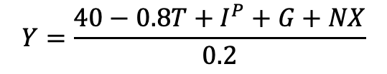
Tutorial Problems
4. An economy is described by the following equations. The multiplier is 5.
$$Y=\frac{40−0.8T+I^{P}+G+NX}{0.2}$$
c. Repeat part b, but this time foreign economies are slowing, reducing the demand for exports, i.e NX = -100
$$ΔY=−100×5$$
Multiplier
But where did it come from?
$$Y=PAE=C+I^{P}+G+NX$$
$$Y=40+0.8(Y−T)+I^{P}+G+NX$$
$$Y−0.8Y=40−0.8T+I^{P}+G+NX$$
$$0.2Y=40−0.8T+I^{P}+G+NX$$

Slide 85

Tutorial Problems
4. An economy is described by the following equations. The multiplier is 5.
$$Y=\frac{40−0.8T+I^{P}+G+NX}{0.2}$$
c. Repeat part b, but this time foreign economies are slowing, reducing the demand for exports, i.e NX = -100
$$ΔY=−100×5$$
Multiplier
$Y=5(40−0.8T+I^{P}+G+NX$)
But where did it come from?
$$Y=PAE=C+I^{P}+G+NX$$
$$Y=40+0.8(Y−T)+I^{P}+G+NX$$
$$Y−0.8Y=40−0.8T+I^{P}+G+NX$$
$$0.2Y=40−0.8T+I^{P}+G+NX$$

Slide 86
Tutorial Problems
4. An economy is described by the following equations. The multiplier is 5.
$$Y=\frac{40−0.8T+I^{P}+G+NX}{0.2}$$
c. Repeat part b, but this time foreign economies are slowing, reducing the demand for exports, i.e NX = -100
$$ΔY=−100×5$$
Multiplier
$Y=5(40−0.8T+I^{P}+G+NX$)
But where did it come from?
$$Y=PAE=C+I^{P}+G+NX$$
$$Y=40+0.8(Y−T)+I^{P}+G+NX$$
Multiplier
$$Y−0.8Y=40−0.8T+I^{P}+G+NX$$
$$0.2Y=40−0.8T+I^{P}+G+NX$$

Slide 87
Tutorial Problems
4. An economy is described by the following equations. The multiplier is 5.
$$C=40+0.8(Y−T)$$
d. How do your results help to explain the tendency of recessions and expansions to spread across countries?
$$I^{P}=70$$
$$G=120$$
$$NX=0$$
$$T=150$$
$$Y^{∗}=580$$

Slide 88
Tutorial Problems
4. An economy is described by the following equations. The multiplier is 5.
$$C=40+0.8(Y−T)$$
d. How do your results help to explain the tendency of recessions and expansions to spread across countries?
$$I^{P}=70$$
$$G=120$$
Spillover effect of foreign macroeconomy.
$$NX=0$$
$$T=150$$
$$Y^{∗}=580$$

Slide 89
Questions?
Slide or Note?

Slide 90
Tutorial Problems
2. The government is considering two alternative policies, one involving increased government purchases of 50 units, the other involving tax cuts of 50 units. Which policy will stimulate planned aggregate expenditure more? Why?

Slide 91
Tutorial Problems
2. The government is considering two alternative policies, one involving increased government purchases of 50 units, the other involving tax cuts of 50 units. Which policy will stimulate planned aggregate expenditure more? Why?

Slide 92

Tutorial Problems
2. The government is considering two alternative policies, one involving increased government purchases of 50 units, the other involving tax cuts of 50 units. Which policy will stimulate planned aggregate expenditure more? Why?
$$PAE=C+I^{P}+G+NX$$

Slide 93

Tutorial Problems
2. The government is considering two alternative policies, one involving increased government purchases of 50 units, the other involving tax cuts of 50 units. Which policy will stimulate planned aggregate expenditure more? Why?
$$PAE=C+I^{P}+G+NX$$
$$C=\overline{C}+c(Y−T)$$

Slide 94


Tutorial Problems
2. The government is considering two alternative policies, one involving increased government purchases of 50 units, the other involving tax cuts of 50 units. Which policy will stimulate planned aggregate expenditure more? Why?
$$PAE=C+I^{P}+G+NX$$
$$G↑50$$
$$C=\overline{C}+c(Y−T)$$

Slide 95


Tutorial Problems
2. The government is considering two alternative policies, one involving increased government purchases of 50 units, the other involving tax cuts of 50 units. Which policy will stimulate planned aggregate expenditure more? Why?
$$PAE=C+I^{P}+G+NX$$
$$G↑50$$
$$C=\overline{C}+c(Y−T)$$
$$PAE↑50$$

Slide 96


Tutorial Problems
2. The government is considering two alternative policies, one involving increased government purchases of 50 units, the other involving tax cuts of 50 units. Which policy will stimulate planned aggregate expenditure more? Why?
$$PAE=C+I^{P}+G+NX$$
$$G↑50$$
$$T↓50$$
$$C=\overline{C}+c(Y−T)$$
$$PAE↑50$$

Slide 97

Tutorial Problems
2. The government is considering two alternative policies, one involving increased government purchases of 50 units, the other involving tax cuts of 50 units. Which policy will stimulate planned aggregate expenditure more? Why?
$$PAE=C+I^{P}+G+NX$$
$$G↑50$$
$$T↓50$$
$$C=\overline{C}+c(Y−T)$$
$$PAE↑50$$
$$C↑50⋅c$$

Slide 98

Tutorial Problems
2. The government is considering two alternative policies, one involving increased government purchases of 50 units, the other involving tax cuts of 50 units. Which policy will stimulate planned aggregate expenditure more? Why?
$$PAE=C+I^{P}+G+NX$$
$$G↑50$$
$$T↓50$$
$$C=\overline{C}+c(Y−T)$$
$$PAE↑50$$
$$C↑50⋅c$$
$$PAE↑50⋅c$$

Slide 99
Tutorial Problems
2. The government is considering two alternative policies, one involving increased government purchases of 50 units, the other involving tax cuts of 50 units. Which policy will stimulate planned aggregate expenditure more? Why?
$$PAE=C+I^{P}+G+NX$$
$$G↑50$$
$$T↓50$$
$$C=\overline{C}+c(Y−T)$$
$$PAE↑50$$
$$C↑50⋅c$$
$$PAE↑50⋅c$$
If c < 1, then 1 stimulate PAE more

